Slide 1
Database designs using Visio
Dr. Sonal Dekhane
ITEC 3200

Slide 2
Database designs
Different than data models
Tables should be normalized
Include column properties
Include primary key/foreign key information
Converts many-many relationship into two one-many relationships using intersection tables

Slide 3
TASKS
Open Highline_University data model created in Visio
For simplicity use the part A model (without the supertype-subtype relationship)
Identify foreign keys (right-click on column name) for all tables
Note that new columns may have to be added to existing tables
Save the drawing as HighlineU_PartA_Design

Slide 4
tasks
Save the Part A design as Part B design
Modify the Part B design to represent the following:
Each student has one adviser. However, they may have multiple advisers during their time at the college. The date of adviser assignment and the date the assignment ended need to be stored.
Each adviser advises many students and is required to advise students.
Similarly modify the relationship between Student and Mentor

Slide 5
Editing data types of columns
Look for an option that allows you to “Show attribute types”
Click on the ”Text Box” tool and then on the type of the attribute
Change the attribute to whatever you like

Slide 6
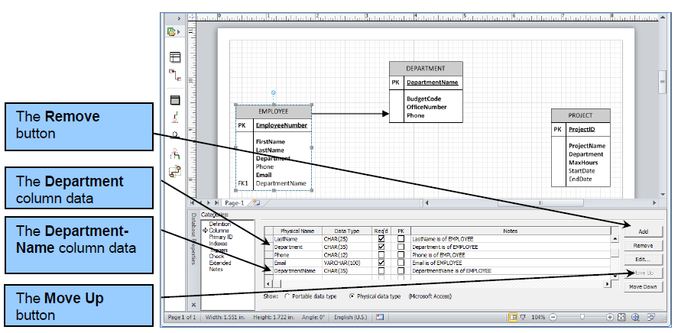
VISIO 2010

Slide 7
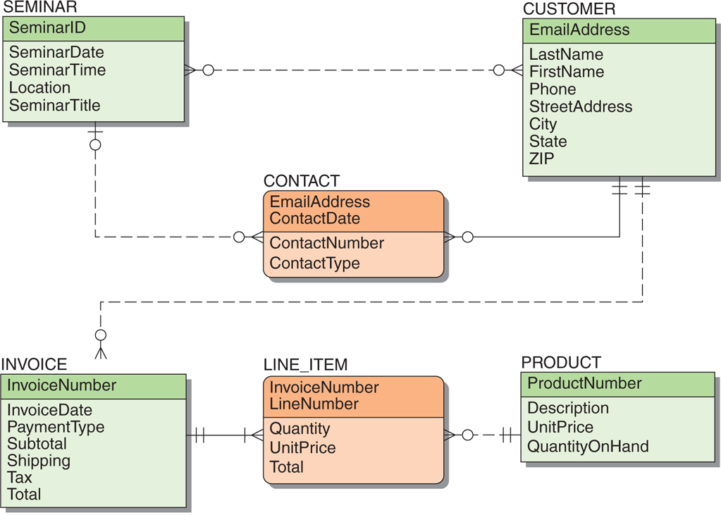
Exercise: Transform Heather Sweeney Data Model into Database design

